Slide 1
Air Quality in America
A Comprehensive Analysis of 42 Years of Data (1980-2022)

Slide 2
Executive Summary: Key Findings
📈 26% improvement in air quality from 1980 to 2022
☀️ Summer months have the worst air quality (July peak: 57.5 AQI)
🏭 Ozone is the dominant pollutant (54% of readings)
📍 California cities consistently rank as worst for air quality
🌍 Geography matters more than population size
⚠️ Extreme events have decreased dramatically since the 1990s

Slide 3
About the Dataset
• 5 million+ air quality readings from EPA monitoring stations
• 42 years of data spanning 1980 to 2022
• Coverage: 634 cities across 52 states/territories
• 5 pollutants tracked: Ozone, PM2.5, PM10, NO2, CO
• Air Quality Index (AQI) used as primary metric
• AQI Categories: Good (0-50), Moderate (51-100), Unhealthy (101+)

Slide 4
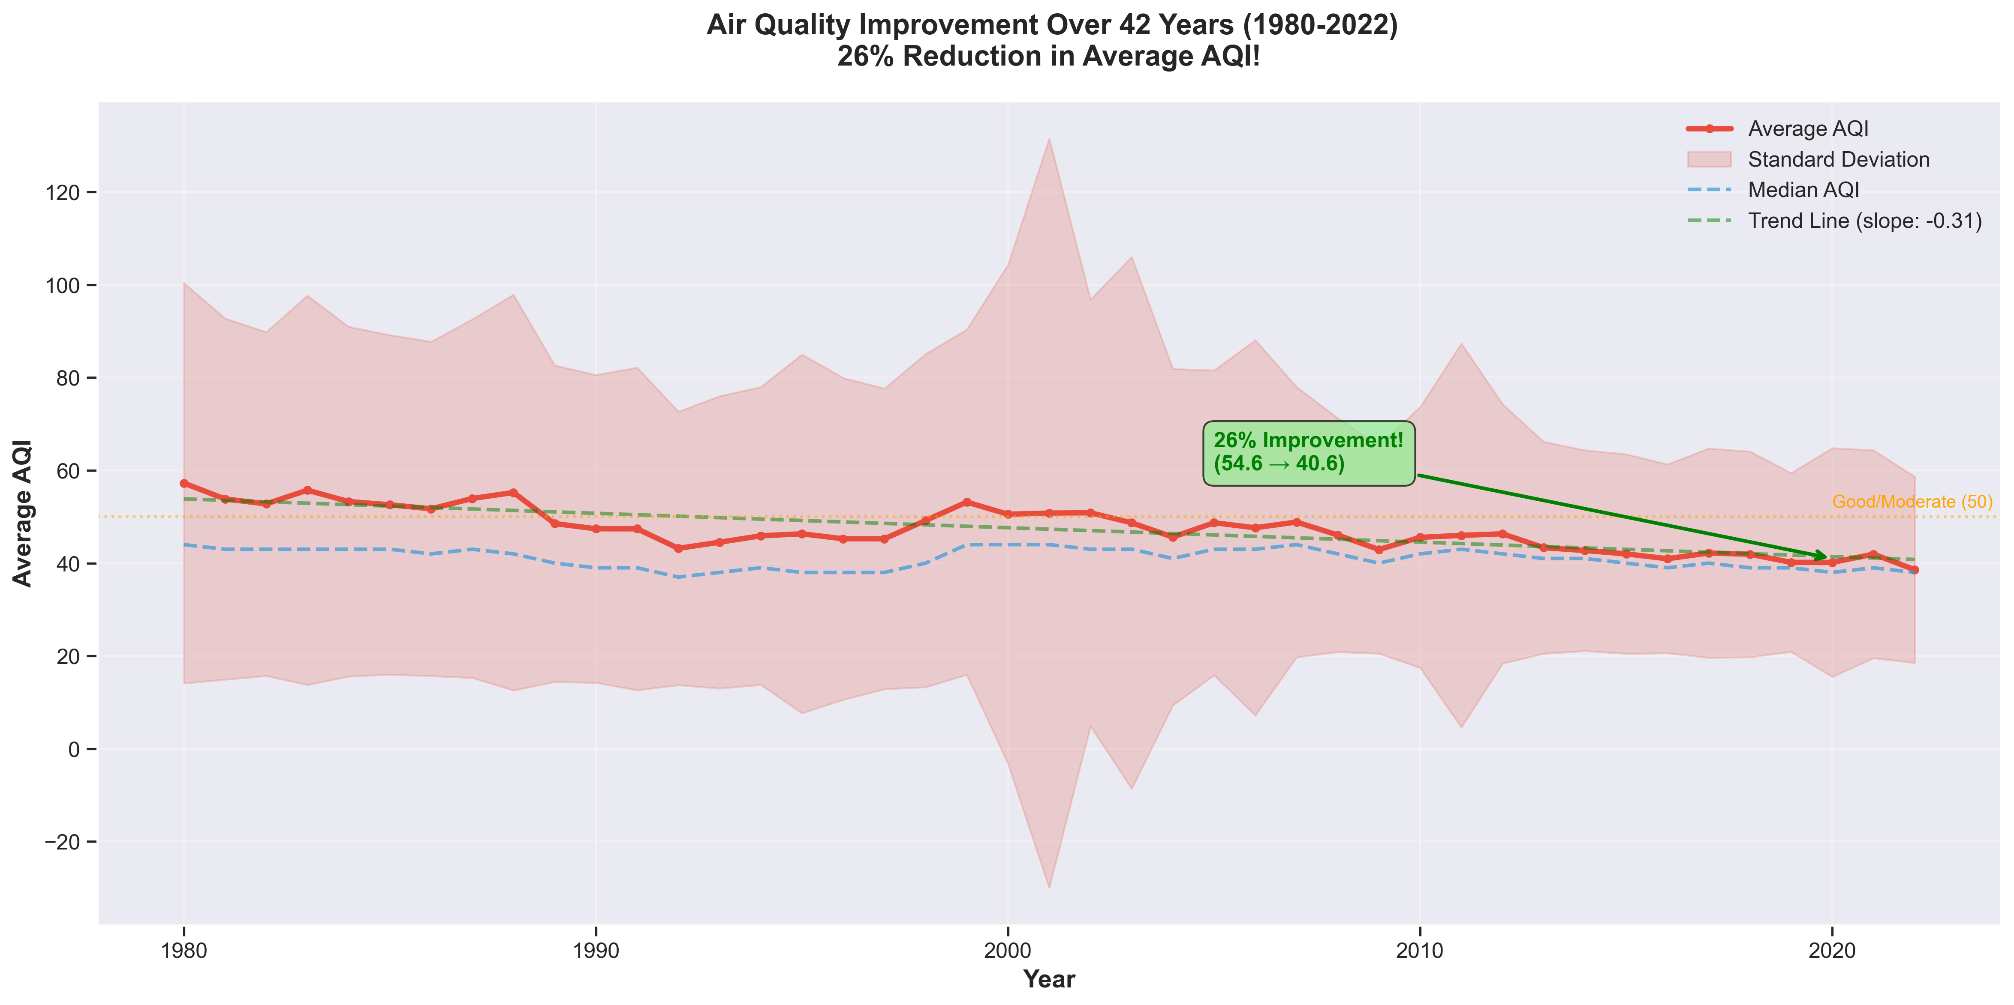
42 Years of Progress: Air Quality Improvement Over Time
• Average AQI decreased from 54.6 to 40.6
• 26% overall improvement in air quality
• Clear downward trend since 1990s
• Clean Air Act regulations showing impact

Slide 5
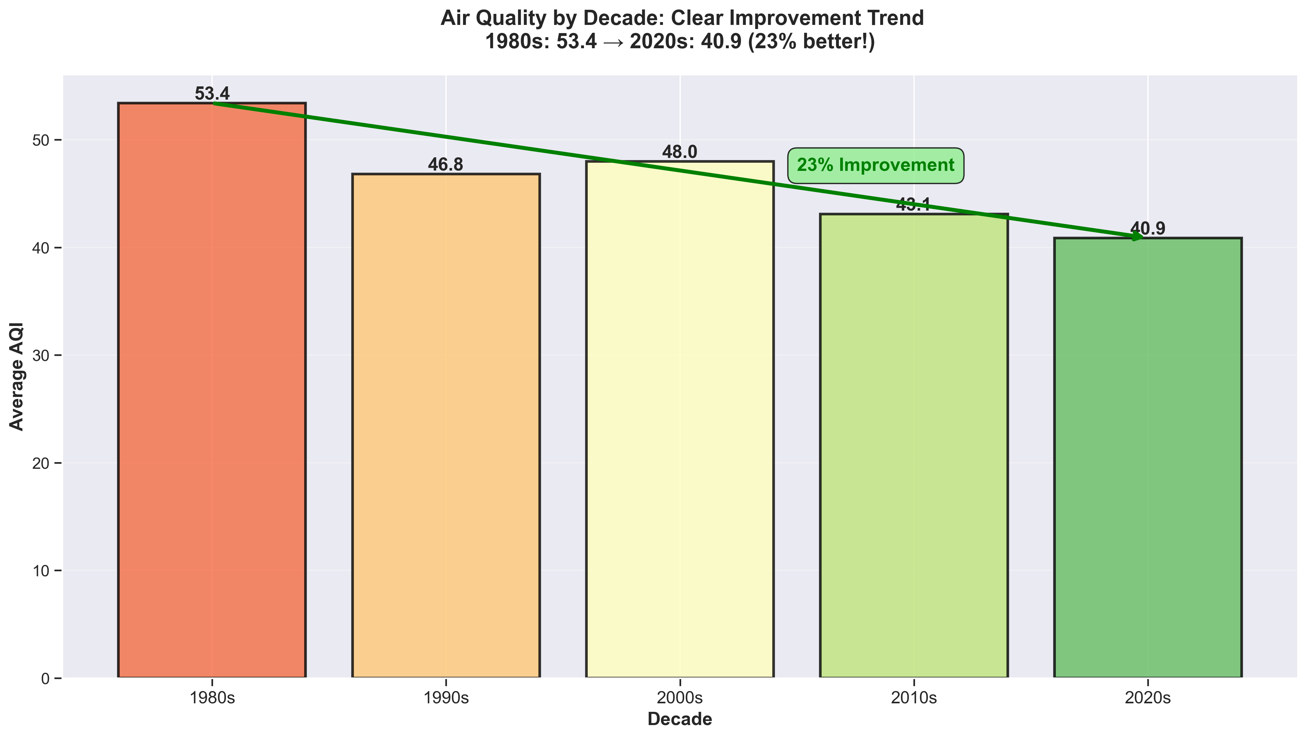
Decade-by-Decade Analysis: Consistent Improvement
• 1980s: Average AQI 53.4 (worst decade)
• 1990s: AQI dropped to 46.8
• 2000s: Slight increase to 48.0
• 2010s: Significant drop to 43.1
• 2020s: Best yet at 40.9 (23% better than 1980s)

Slide 6
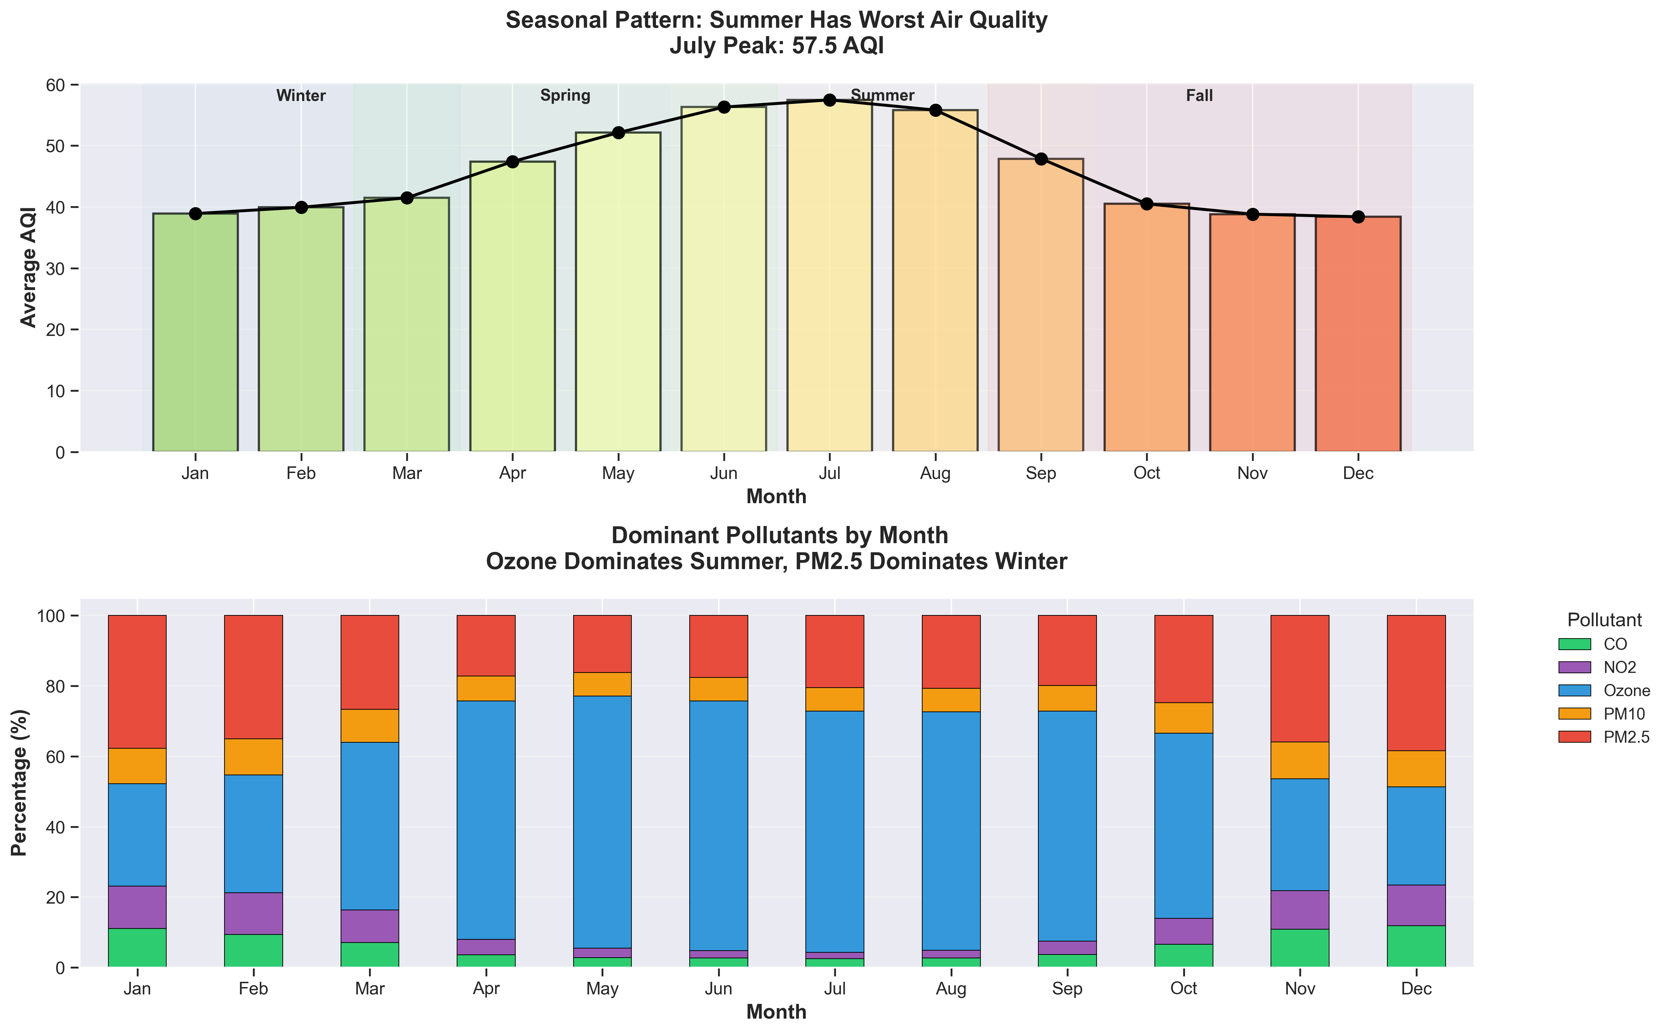
Seasonal Patterns: Summer Has Worst Air Quality
• July peak: 57.5 AQI (highest month)
• Winter months: Lowest AQI readings
• Ozone dominates in summer
• PM2.5 more prevalent in winter
• Temperature and sunlight drive patterns

Slide 7
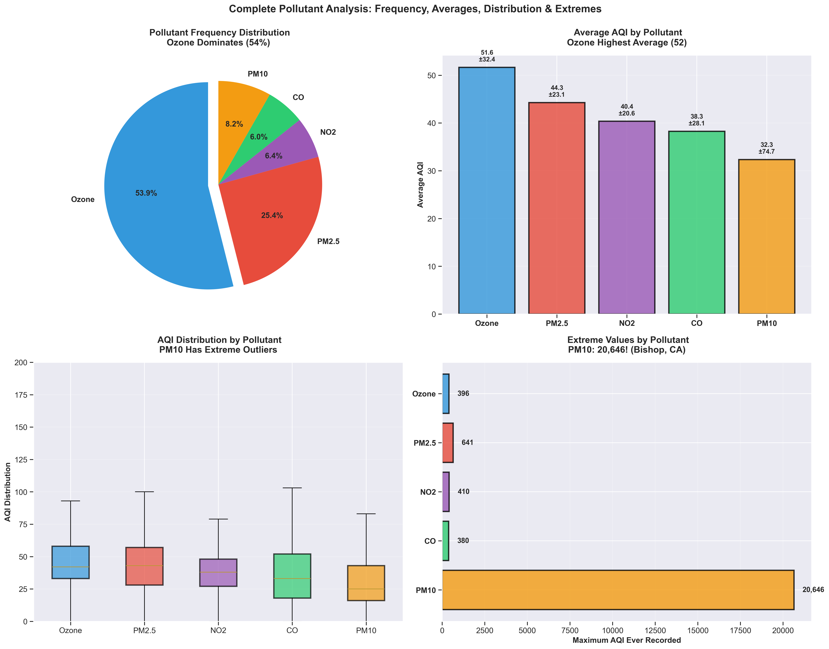
Pollutant Overview: Ozone Dominates
• Ozone: 54% of all readings (most common)
• PM2.5: 25% of readings
• Ozone has highest average AQI (51.6)
• PM10 has extreme outliers (max: 20,646!)
• CO shows lowest average levels

Slide 8
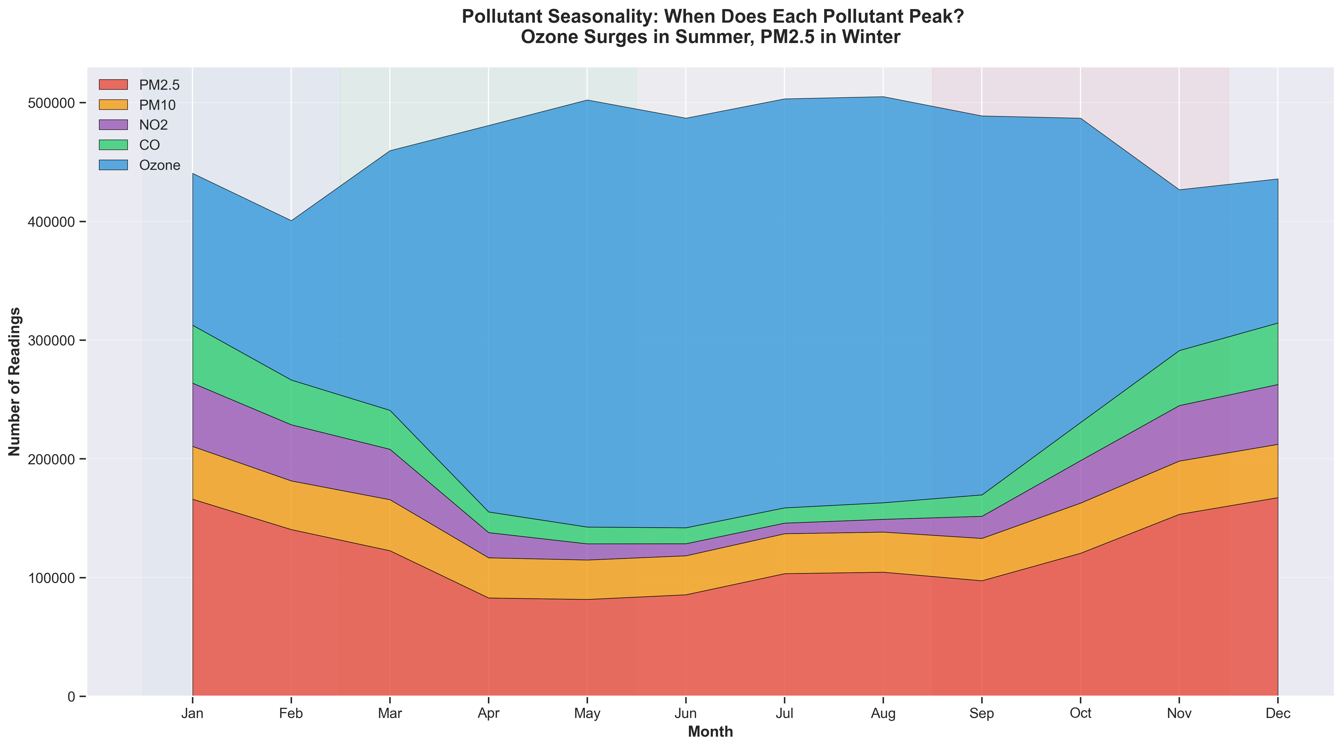
Pollutant Seasonality: Different Pollutants Peak at Different Times
• Ozone surges dramatically in summer
• PM2.5 peaks in winter months
• NO2 relatively stable year-round
• PM10 shows spring peaks (dust seasons)
• Understanding seasonality helps planning

Slide 9
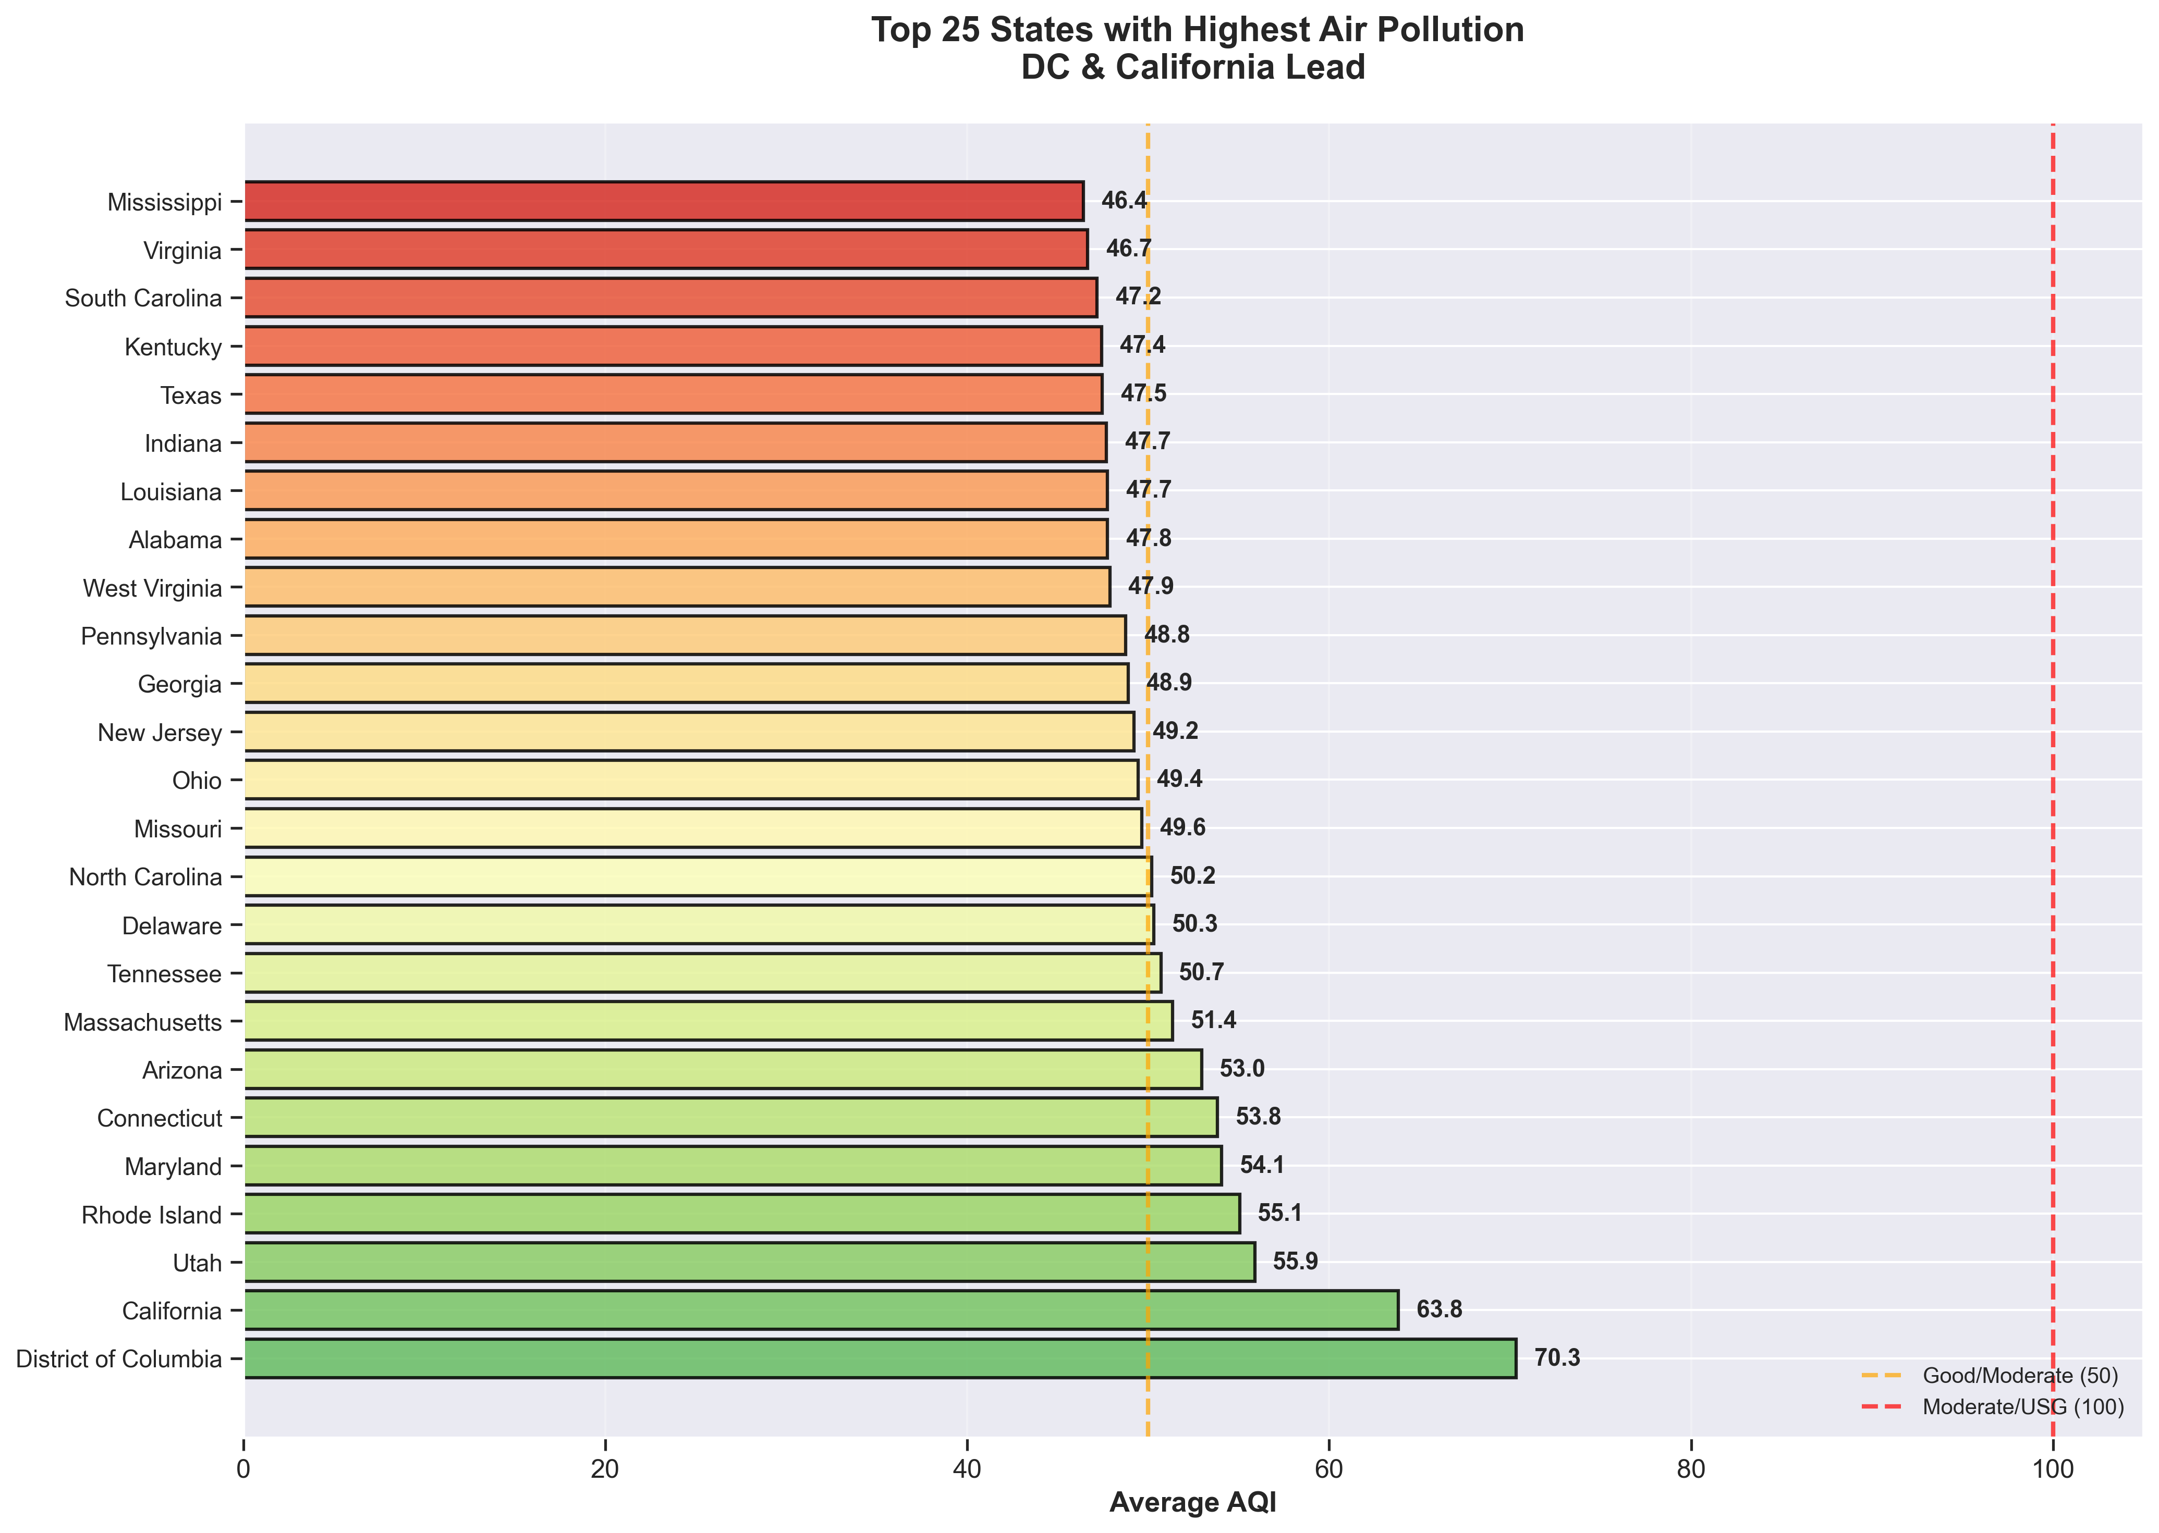
State Rankings: Who Has the Worst Air Quality?
• District of Columbia leads (70.3 AQI)
• California second worst (63.8 AQI)
• Utah, Rhode Island, Maryland follow
• Mississippi has best air (46.4 AQI)
• Most states fall in 'Good' category

Slide 10
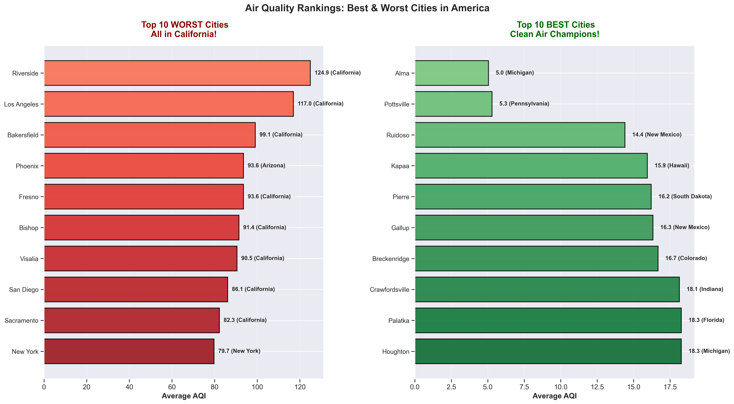
City Rankings: Best and Worst Cities in America
• TOP 10 WORST CITIES - All in California!
• Riverside #1 worst (124.9 AQI)
• Los Angeles, Bakersfield, Fresno follow
• TOP 10 BEST CITIES - Diverse locations
• Alma, MI cleanest (5.0 AQI)
• Clean cities found across many states

Slide 11
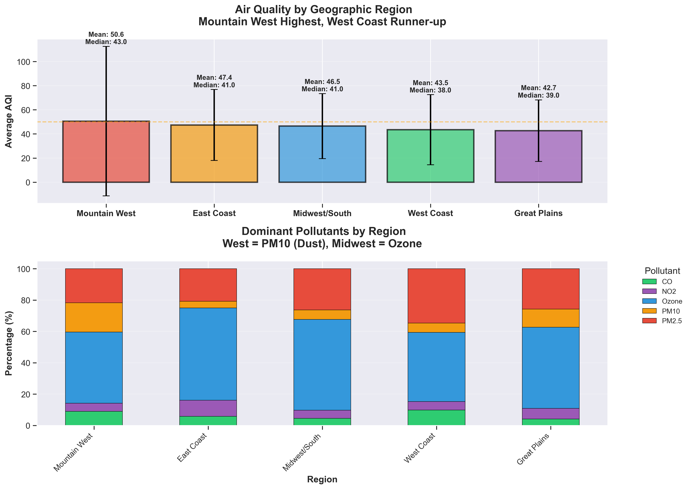
Regional Analysis: Geography Matters
• Mountain West: Worst region (50.6 AQI)
• Great Plains: Best region (42.7 AQI)
• West Coast high due to PM10 (dust)
• Midwest/South: Ozone dominant
• Regional variations in pollutant types

Slide 12
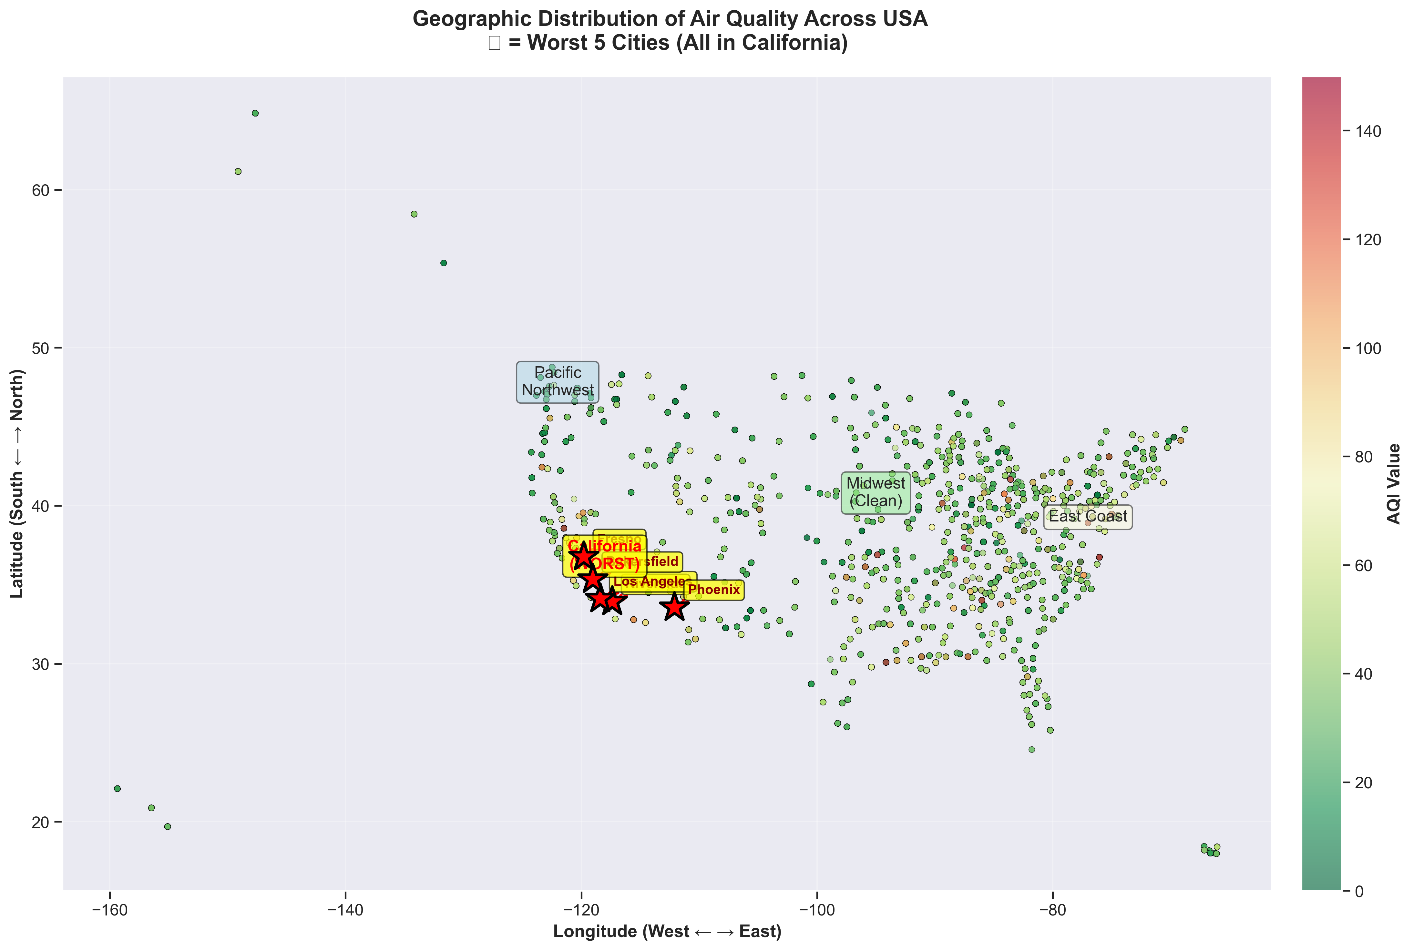
Geographic Distribution: Mapping Air Quality Across the USA
• All 5 worst cities located in California
• Midwest shows consistently clean air
• East Coast: Moderate levels
• Pacific Northwest: Generally good
• Clear geographic clustering patterns

Slide 13
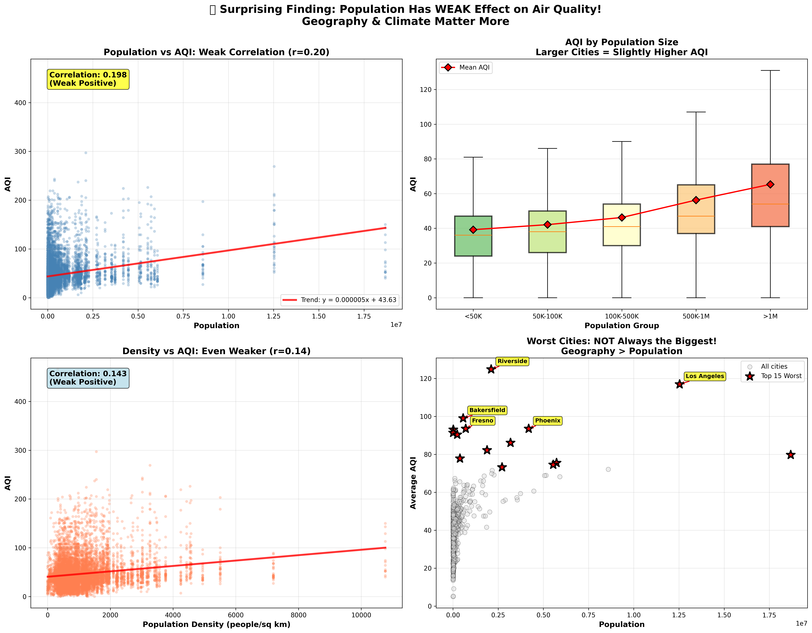
Surprising Finding: Population Has WEAK Effect on Air Quality
• Correlation r=0.20 (weak positive)
• Population density r=0.14 (even weaker!)
• Geography and climate matter more
• Worst cities are NOT always the biggest
• Riverside worse than NYC despite size

Slide 14
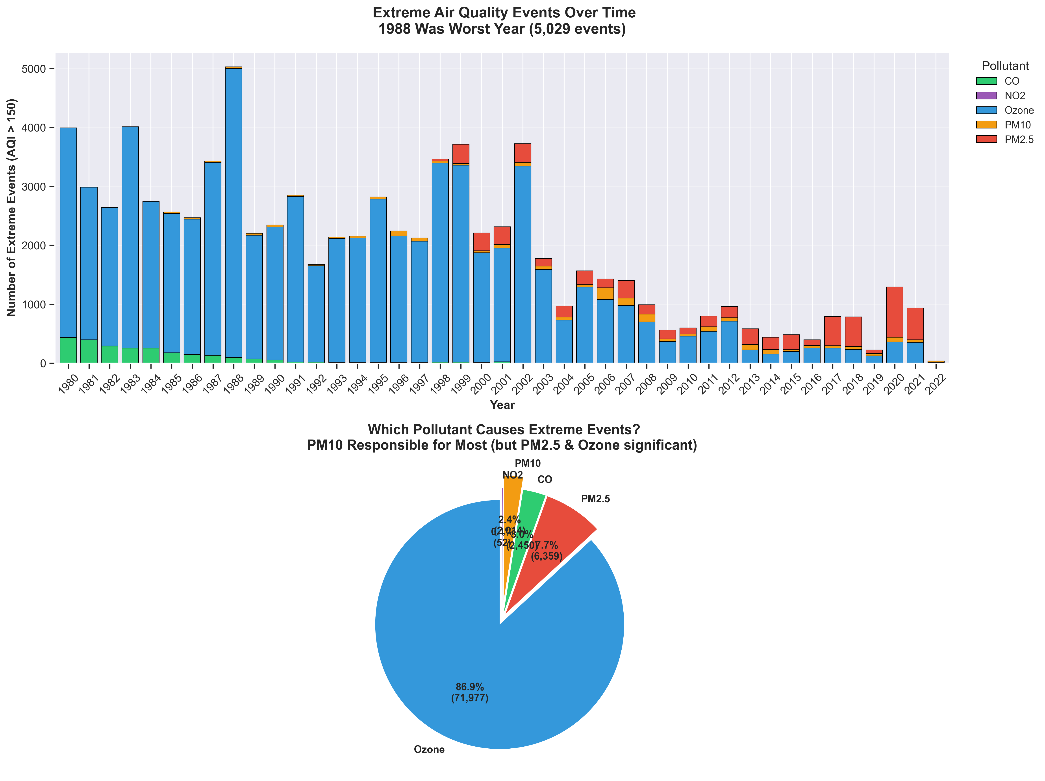
Extreme Air Quality Events: A Success Story
• 1988: Worst year with 5,029 extreme events
• Dramatic decline since the 1990s
• Ozone causes 56% of extreme events
• PM2.5 responsible for 38% of extremes
• 2020s: Fewer than 500 events per year

Slide 15
Conclusions & Future Recommendations
✅ Air quality regulations (Clean Air Act) are working
🎯 Focus on California - consistently worst performer
☀️ Summer interventions crucial (Ozone peaks)
🏙️ City size alone doesn't predict air quality
📊 Continue monitoring PM2.5 and Ozone as top concerns
🔮 Data-driven decisions can further improve outcomes

